Slide 1
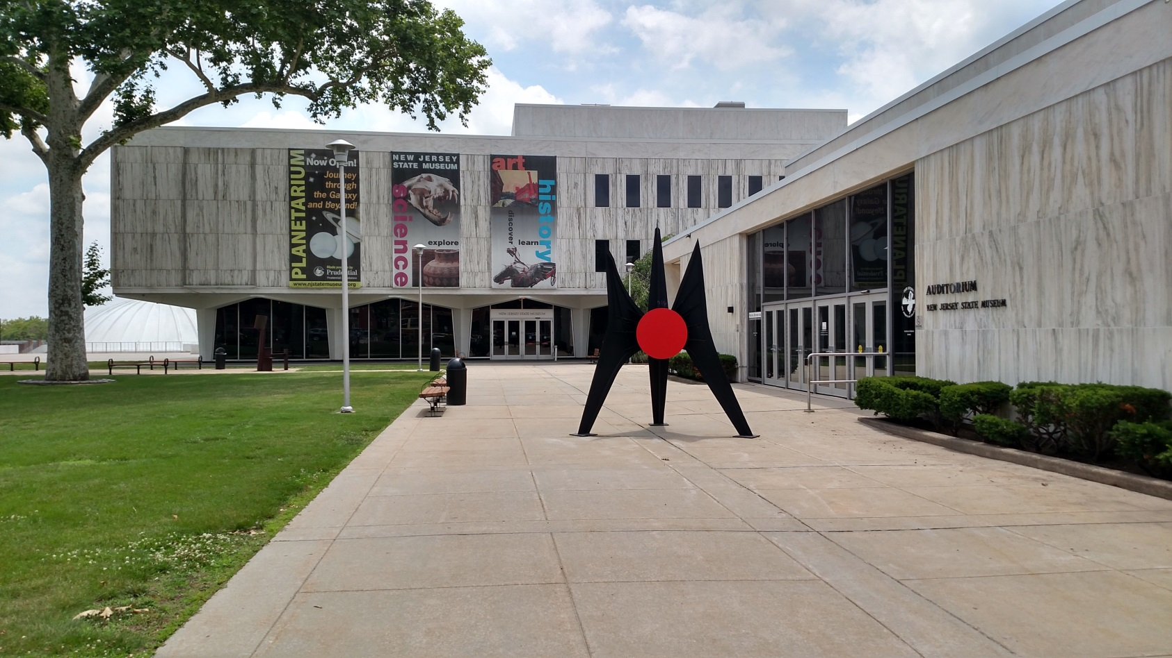
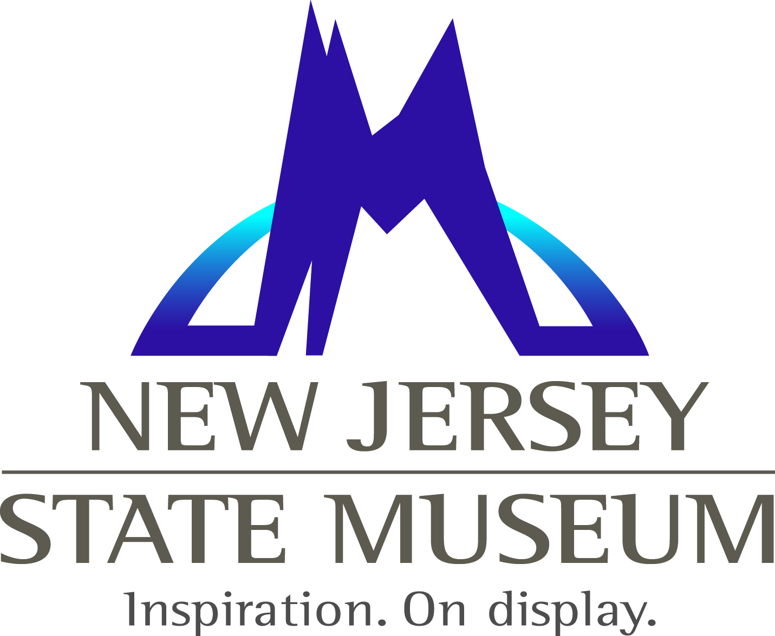
Collections Management
Paula M. Andras
Registrar, Bureau of Cultural History
New Jersey State Museum

Slide 2
What is a Registrar?
Registrars are charged with the well-being of their collections, which includes deciding how they will be stored and displayed.
Registrars keep track of objects by assigning numbers, keeping location changes accurate, and creating exhibit matrices.
Registrars prepare lots of paperwork for accessions, loans, cataloging, environmental conditions, and pest management.

Slide 3
How does a regular old thing come to live inside a museum?
Begins with a phone call or email.
(2) A few questions are asked:
a. Does it meet our museum’s Mission Statement?
b. Do we have any pieces like this in our collection?
c. Is the object in good condition?

Slide 4
New Jersey State Museum
Mission Statement
As a center of cultural, educational and scientific engagement, the New Jersey State Museum inspires innovation and lifelong learning through collections, research, exhibitions and programs in science, history and art. NJSM engages visitors of all ages and diverse backgrounds in an exploration of New Jersey’s cultural and natural history presented within a global context, fosters state pride, and serves as a cultivator of tomorrow’s leaders.

Slide 5
NJSM Collections Policy:
Cultural History

Slide 6
Donation

Slide 7
Incoming Loan

Slide 8
Outgoing Loan

Slide 9
Collections Committee
  Consists of the Registrars and Curators of all four Bureaus
  Discuss if the object fits into the Mission Statement
  Decide if we have space
  Ultimately it is the decision of the Bureau whether object fits with their collections

Slide 10

Accession Book
The most significant book in collections management!

Slide 11
Accession Report

Slide 12
Cataloging

Slide 13
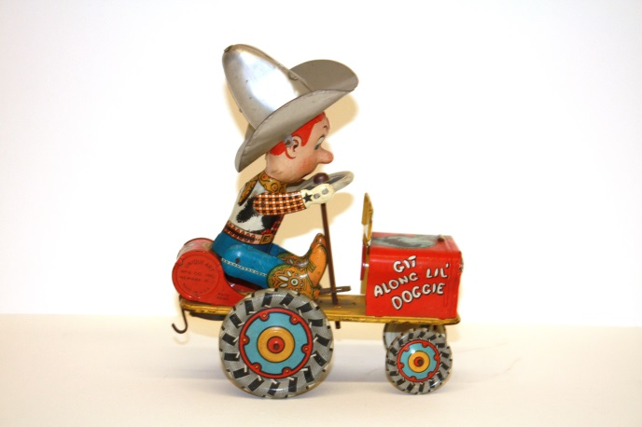
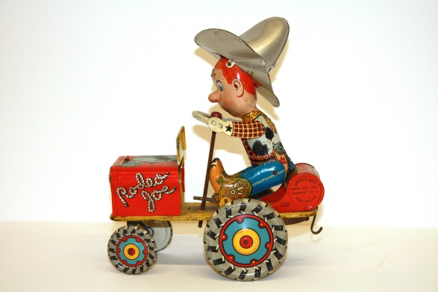
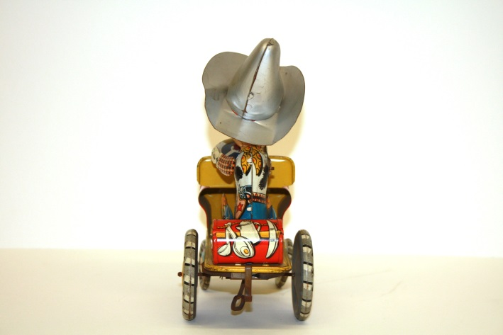
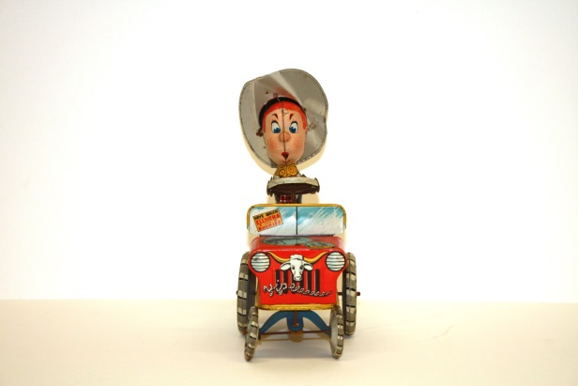
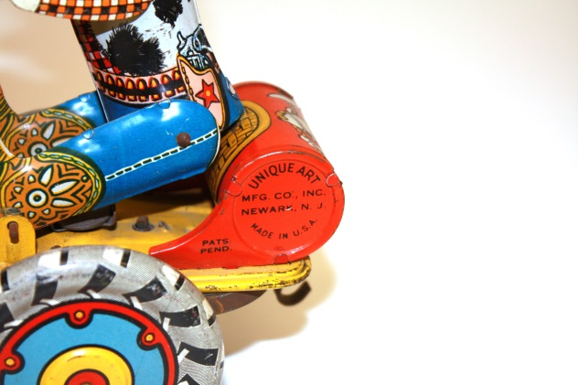
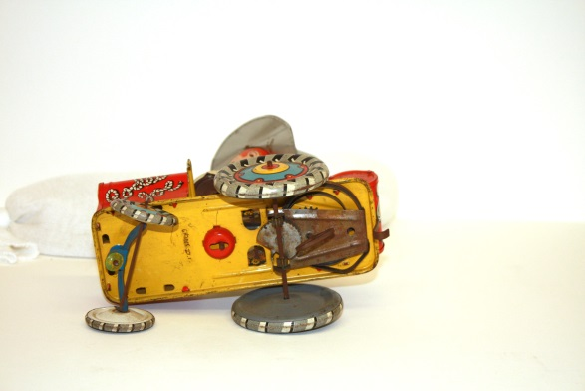
Photography

Slide 14
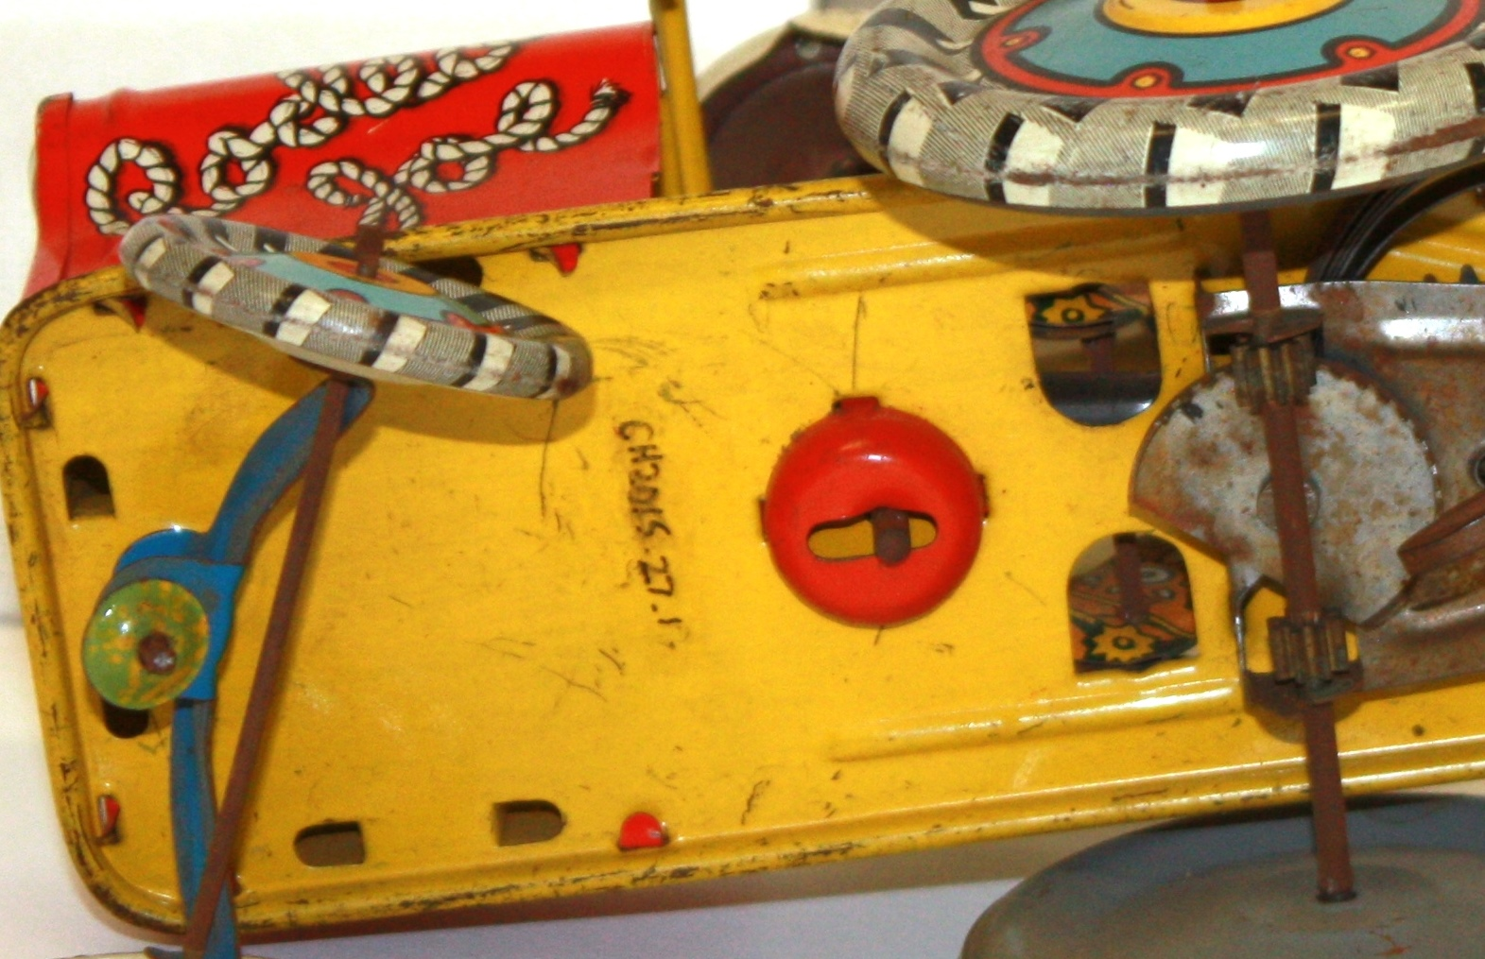
Numbering

Slide 15
Storage
The Bureau of Cultural History has around 15,000 objects in its collection, with about 10% on exhibit.
We share storage space with the other three bureaus, and we have our own space as well.
Every object has a specific location, and any changes to that object’s location must be recorded.

Slide 16
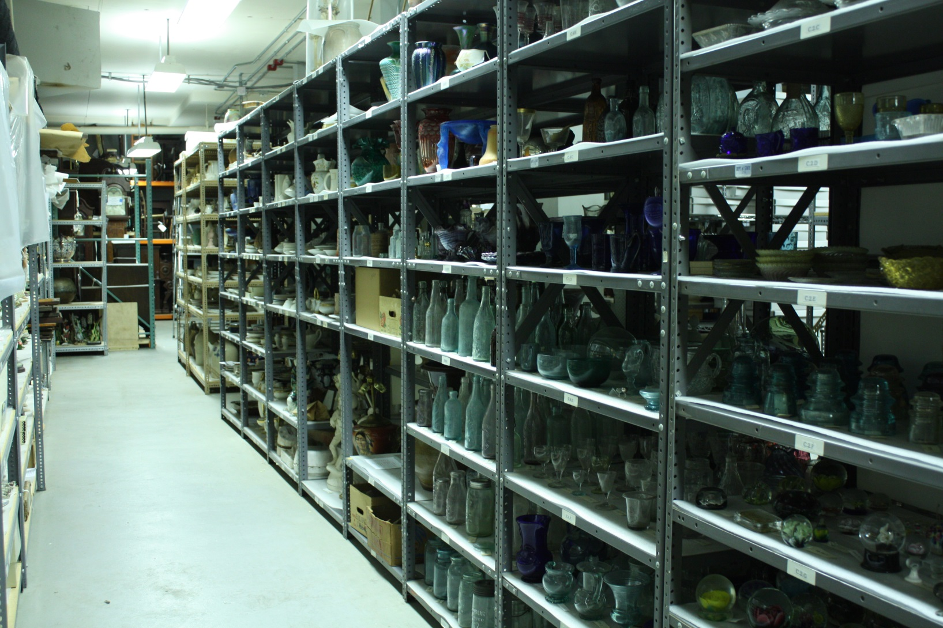
Off-Site Storage Space

Slide 17
Cultural History Exhibits
We are responsible for five long-term exhibits in three different buildings in Trenton.
Our next exclusive exhibit will focus on New Jersey-made toys and will open in 2017!

Slide 18
Exhibit Object Matrix
Section | Object ID # | Object | Date | Dimensions | Storage | Notes
1 | CH1968.167.11 (2) | Vase | c. 1870s-1880s | 4.25 x 4 x 4 | B.7.e | Two numbered the same
1 | CH1968.167.11 (2) | Vase | c. 1870s-1880s | 4.25 x 4 x 4 | B.7.e | Two numbered the same
1 | CH1979.1.20.1 | Vase | 1880s | 7 x 3.5 x 3.5 | C.14.c
1 | CH1979.1.20.2 | Vase | 1880s
1 | CH354.17 b | Cream Jug | 1880 | 5 x 5 x 3.5 | C.13.b
1 | CH354.17 a,c | Teapot
1 | CH1979.1.50 a,b? | Medal | c. 1884-85 | 2.5 diameter | A.1.q
1 | CH1979.1.51 a,b? | Medal | 1879 | 2 diamter | A.1.q
1 | REPRO | Wm Tams portrait |  | 8 x6 | A.2.G vlt | 1979.1.53h
1 | REPRO | James Tams at desk |  | 8x10 | A.2.G vlt | 1979.1.53k
1 | REPRO | Edwin Tams in office |  | 8x10 | A.2.G vlt | 1979.1.53.l
1 | REPRO | Employees outside, Tams |  | 6.25x8.25 | A.2.G vlt | 1979.1.53i
1 | REPRO | Map of Trenton | c. 1880 | 11 x 17 | nick | unaccessioned
1 | REPRO | Greenwood pottery façade | c. 1880 | scan | nick | 1979.1.55a
2 | REPRO | Tams design drawing | c. 1880 | 7x6 | A.2.G vlt | 79.1.52a
2 | REPRO | Tams design drawing | c. 1880 | 8.25 x 8.25 | A.2.G vlt | 719.1.52b
2 | REPRO | Tams design drawing | c. 1880 | 7.75 x 6w | A.2.G vlt | 79.1.52c
2 | REPRO | Tams design drawing | c. 1880 | 6 x 4.5 | A.2.G vlt | 79.1.52e
2 | REPRO | Tams design drawing | c. 1880 | 6.25 x 3.5 | A.2.G vlt | 79.1.52g
2 | REPRO | Tams design drawing | c. 1880 | 8.25 x 8.75 | A.2.G vlt | 79.1.52k
2 | REPRO | Tams design drawing | c. 1880 | 8 x 5 | A.2.G vlt | 79.1.52j
2 | REPRO | Tams design drawing | c. 1880 | 6.5 x 4.25 | A.2.G vlt | 79.1.52f
3 | CH1979.1.4 | Vase | c. 1883 | 7 x 4.5 x 4.5 | C.13.b
3 | CH1979.1.5 | Vase | 1889 | 15 x 6.5 x 6.5 | C.17.a or A.6.b
3 | CH1979.1.6 a,b | Covered Urn | c. 1880-1890 | 16 x 8 x 8 | C.13.a or A.6.d
3 | CH1979.1.7 | Vase | c.1880-1890 | 8.5 x 3 x 3 | C.13.b
3 | CH1979.1.9 | Vase | 1880s | 8.5 x 3.5 x 3.5 | C.13.b
3 | CH1979.1.13 a,b? | Jar with Lid | 1880s | 6.5 x 4 x 4 | C.13.b
3 | CH1979.1.14 a,b | Jar with Lid | 1880s | 6.5 x 4 x 4 | C.13.b

Slide 19
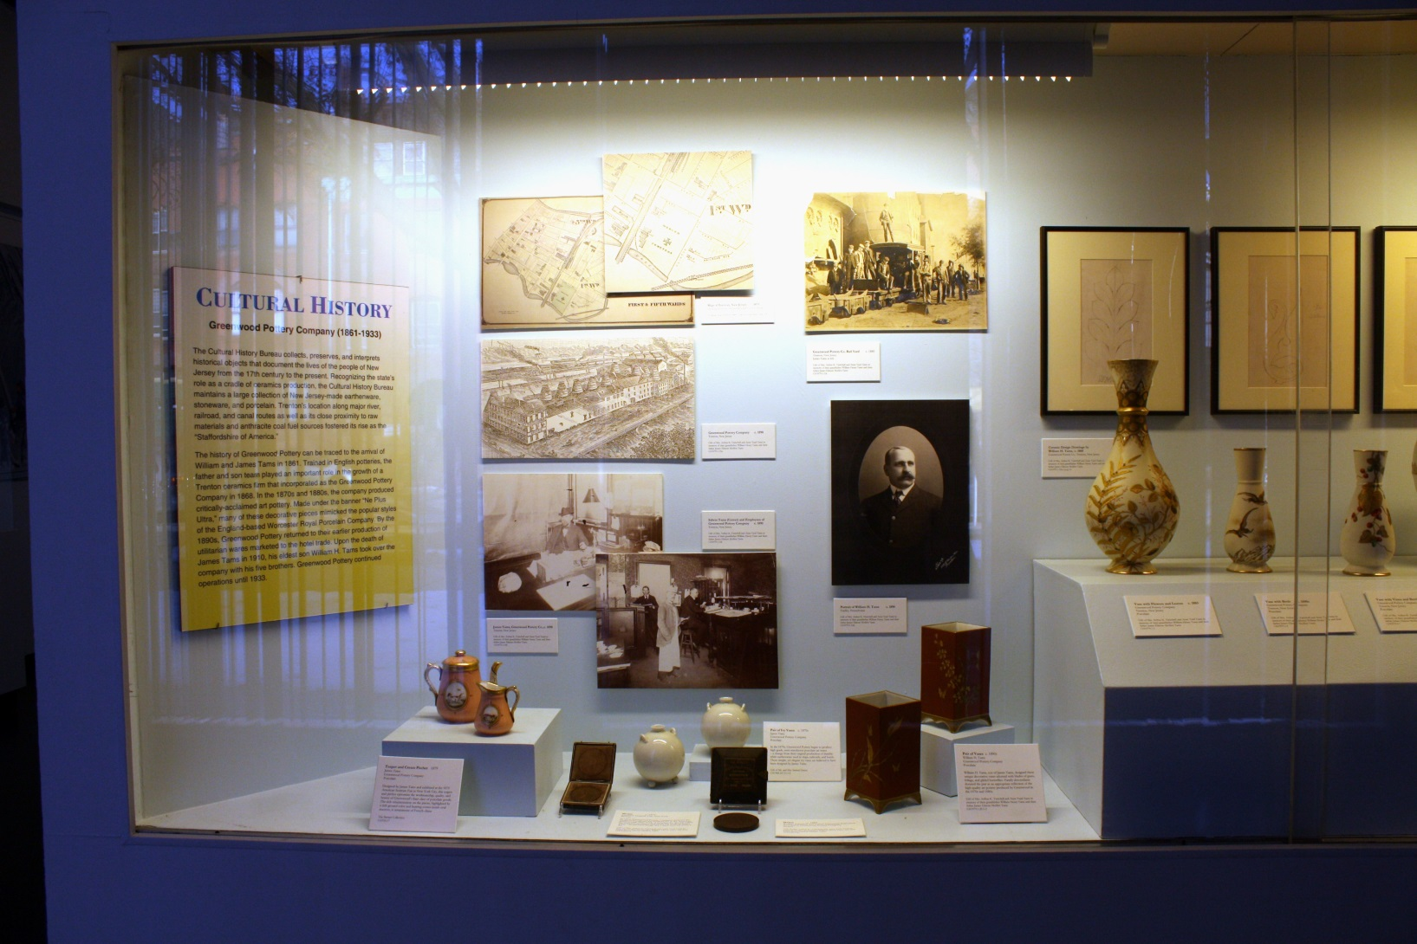
Experience Your State Museum: Cultural History

Slide 20
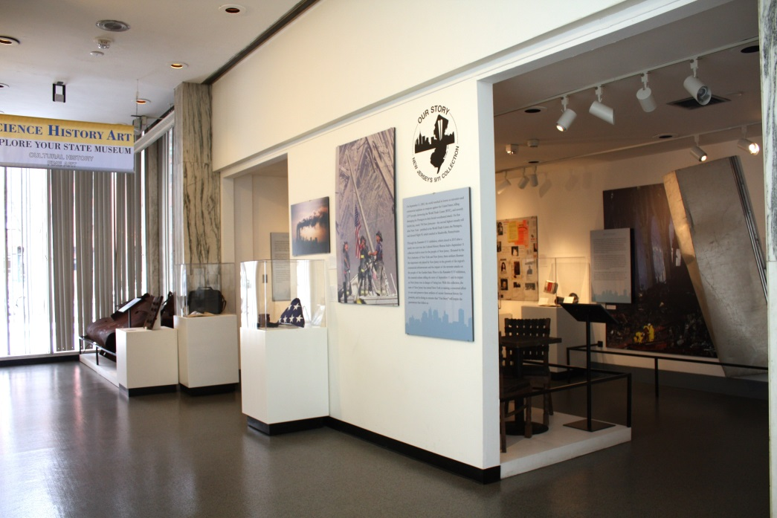
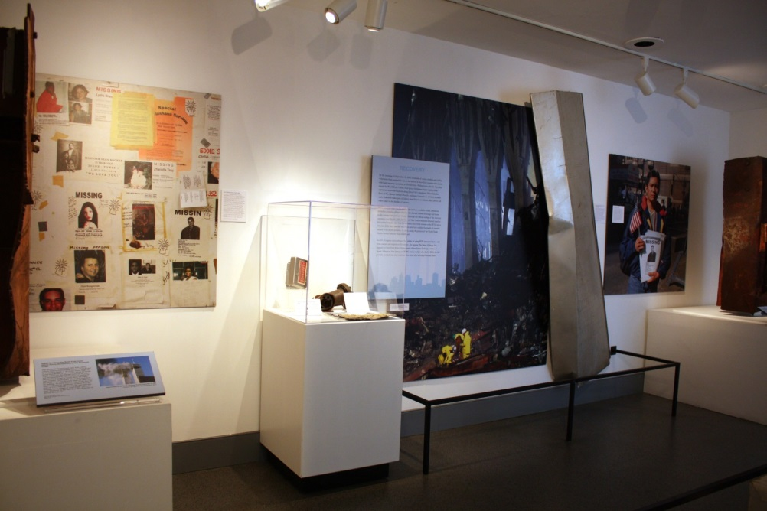
Our Story: New Jersey’s 9/11 Collection

Slide 21
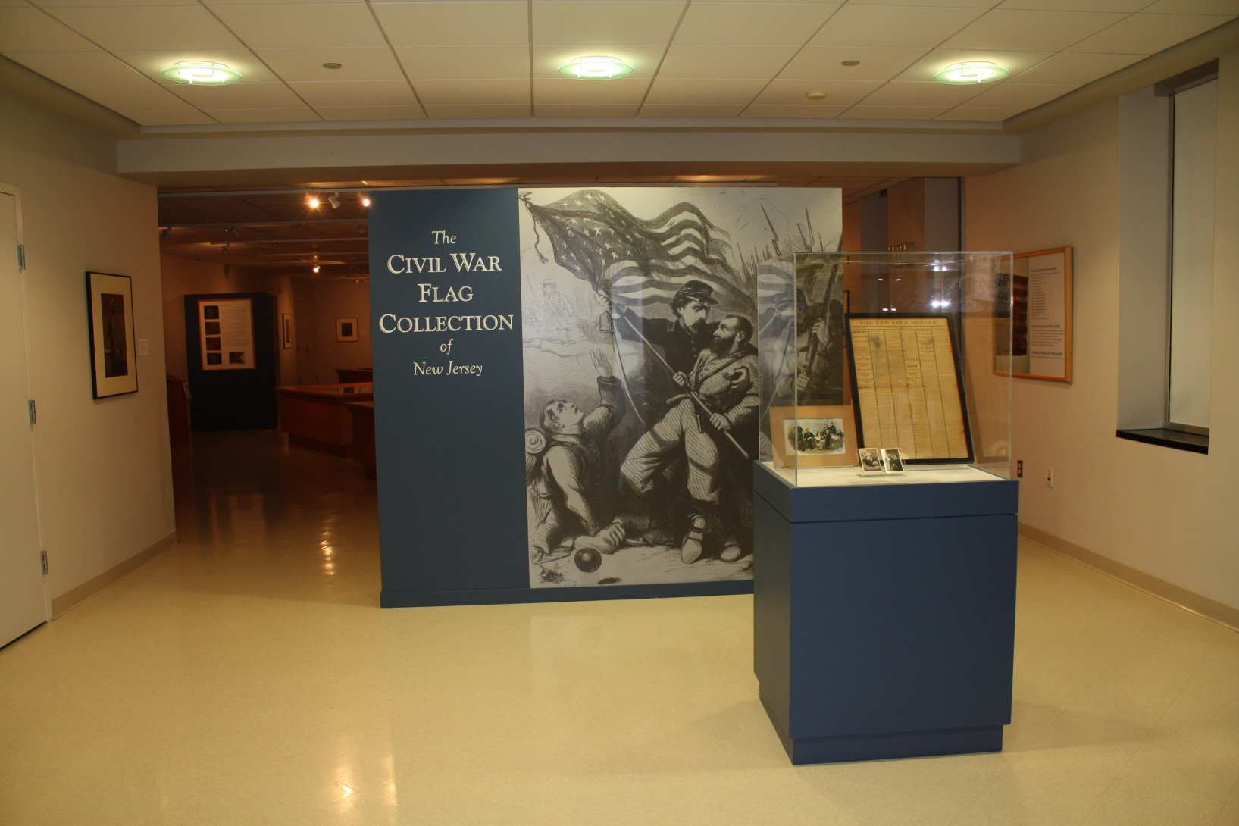
The Civil War Flag Collection of New Jersey

Slide 22
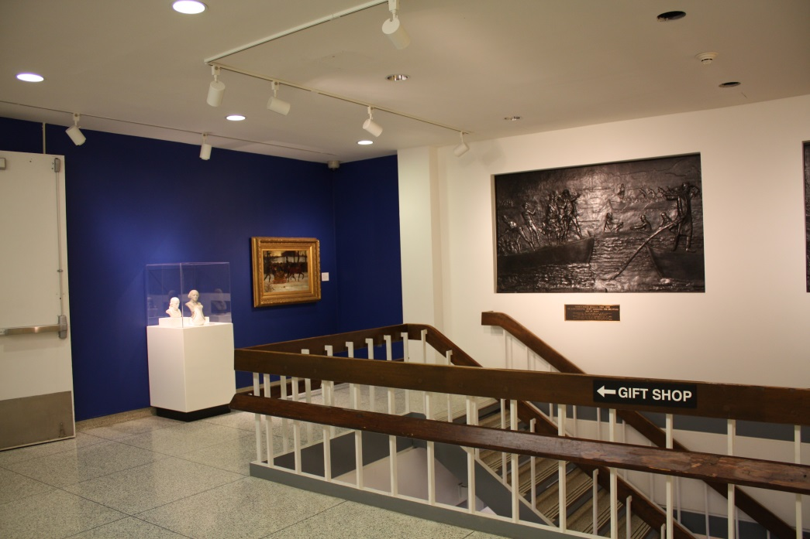
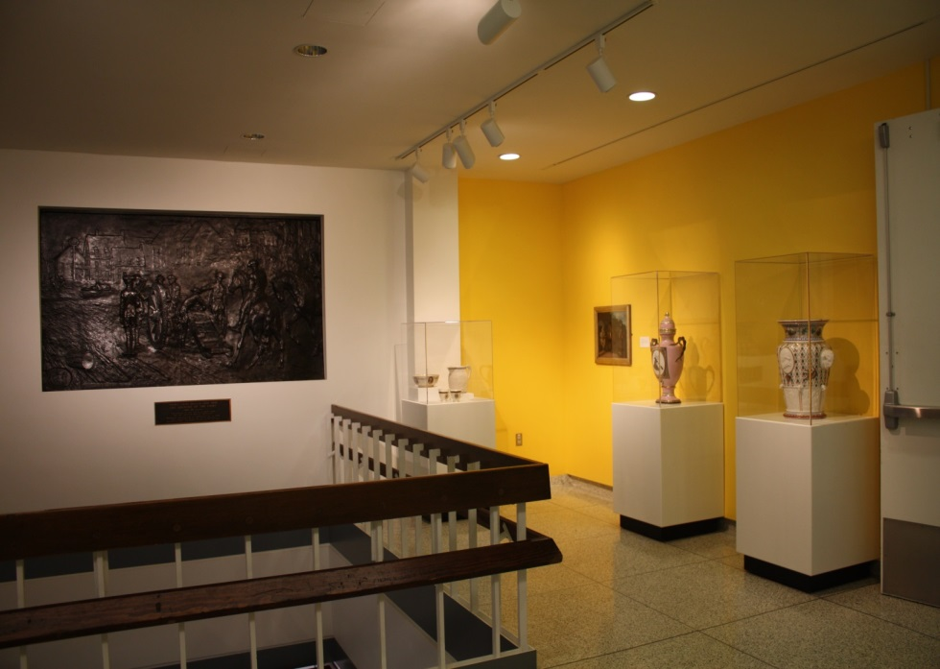
Remembering the Revolution

Slide 23
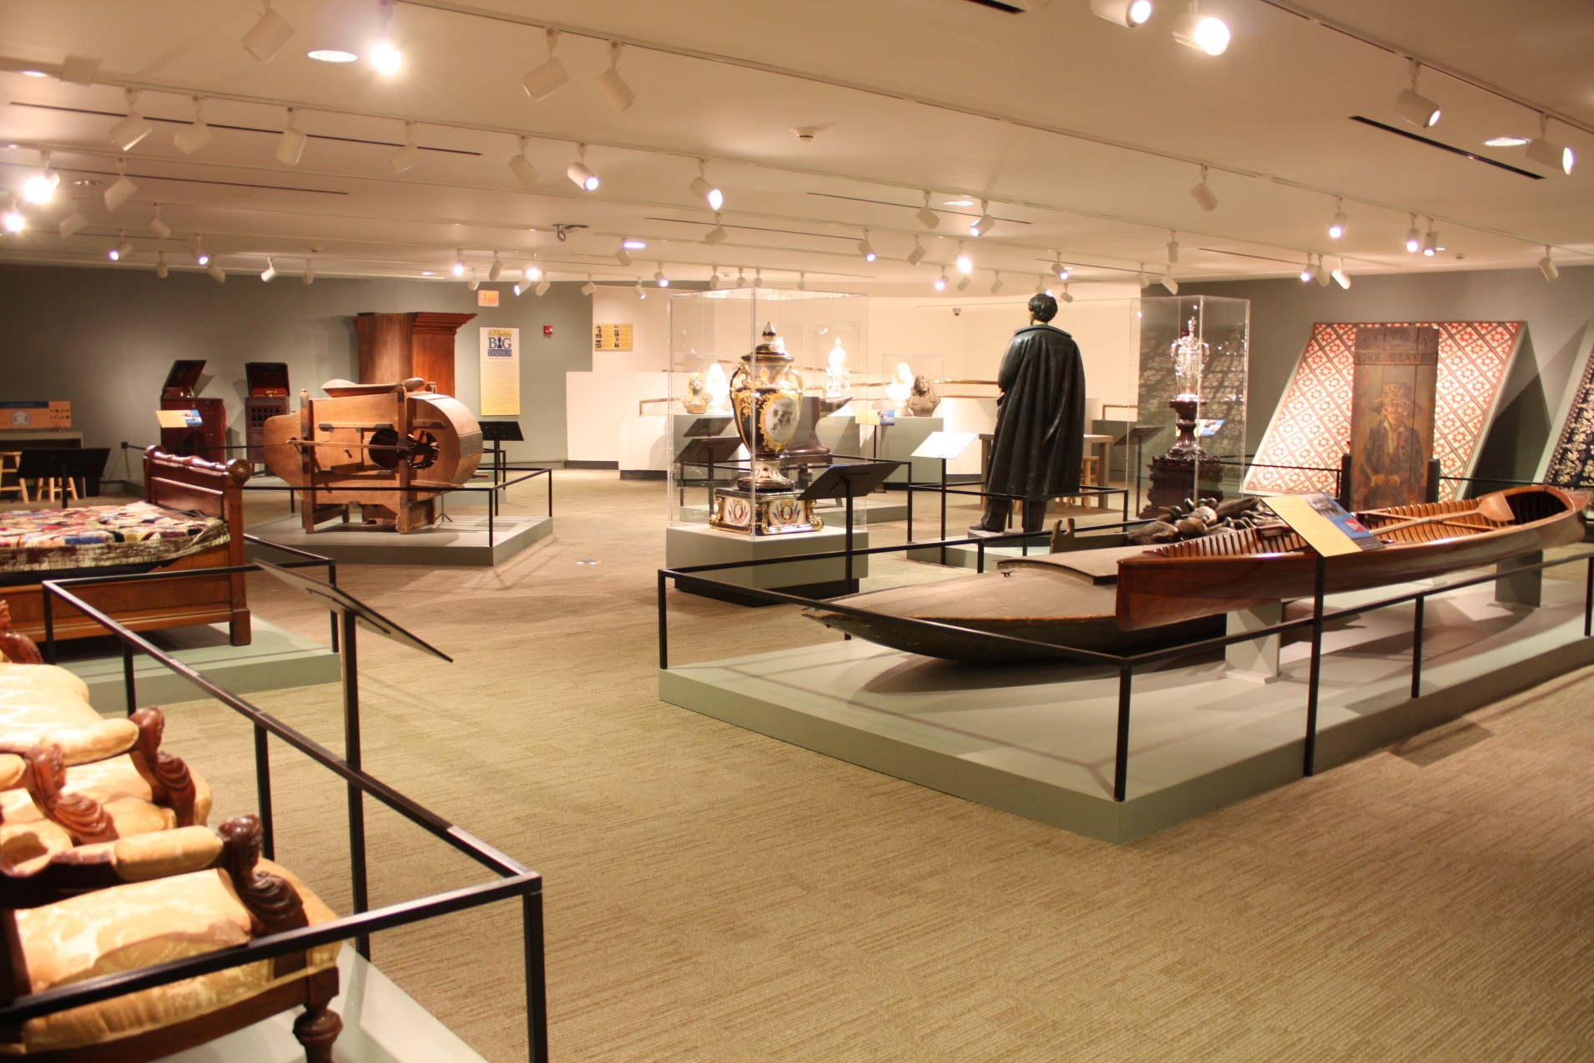
Pretty Big Things: Stories of New Jersey History

Slide 24
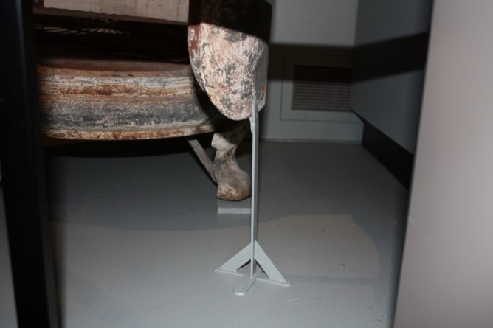
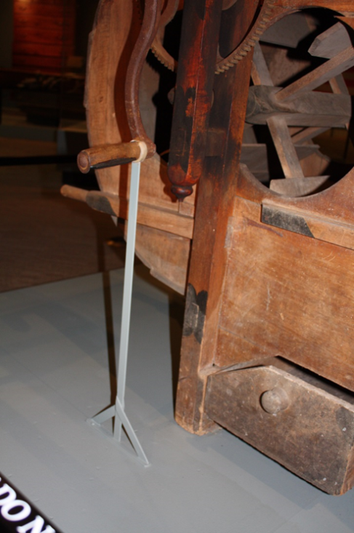
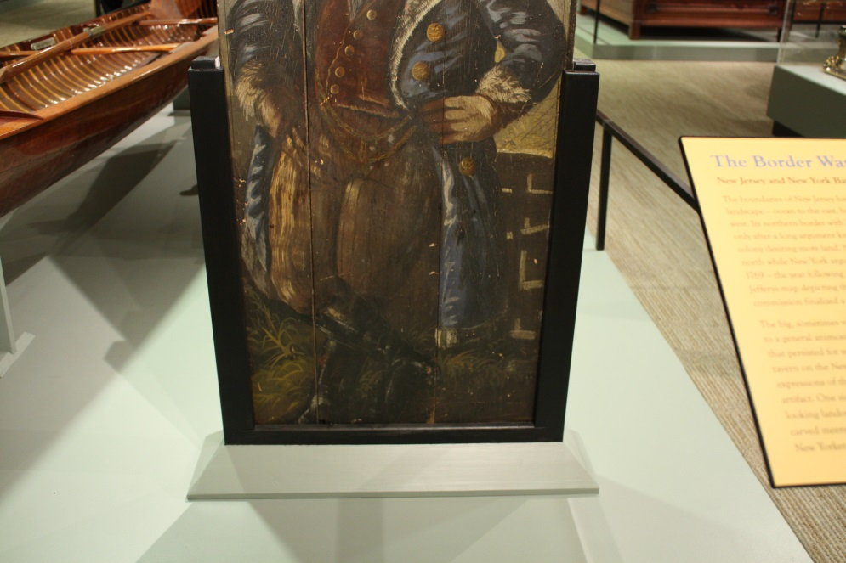
Mounts: Pretty Big Things
CH1967.94: Ice Box door
CH1977.47.1, .2: Fanning Mill handle
CH2013.5.1: Tavern Door Sign

Slide 25
So what is a Registrar?

Slide 26
Registrars are meticulous.
We compromise, but never at the expense of our collections.
And we are always right, so arguing with us is futile. ☺

Slide 27
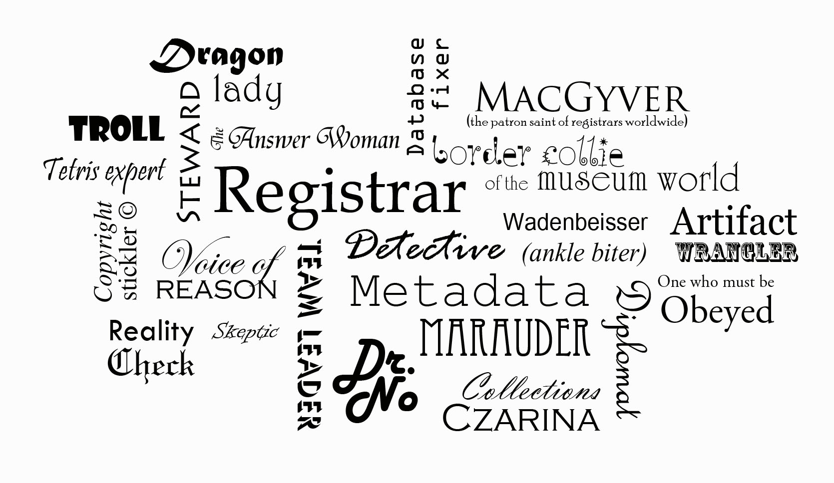
In other words...

